Slide 1
Cancer Screening Update IDCA Meeting
September 20, 2013

Slide 2
Overview
Ontario’s Cancer Screening Programs
Ontario Breast Screening Program (OBSP)
CR Mammography Technology Transition Project

Slide 3
Ontario’s Cancer Screening Programs
Ontario Breast Screening Program
ColonCancerCheck Program
Ontario High Risk Breast Screening Program
1990
2008
2011
Cancer Screening
Announcement for Ontario Cervical Screening Program
2000

Slide 4
Cancer Screening Goal
Accelerate reduction in cancer mortality by implementing a coordinated, organized cancer screening program across Ontario

Slide 5
Organized Screening Program (IARC)
Features |  | OBSP | Non – OBSP | OCSP | CCC
Recent Ontario/PEBC guidelines |  |  |  |  | 
Initiatives to increase screening participation | Public |  |  |  | 
 | Providers |  |  |  | 
Routine recall |  |  |  |  | 
Follow-up of abnormal results |  |  |  |  | 
QA |  |  |  |  | 
Monitoring/evaluation |  |  |  |  | 
Information system |  |  |  |  | 
 Yes  Partial  No
Not for reproduction
Notes:
Key Messages
IARC = International Agency for Research on Cancer.
IARC recommends the success of any population based screening program relies on having a program that conforms to evidence-based standards and procedures within an overall programmatic framework.
This program framework has key features related to standards, initiatives for increasing participation, recall, follow-up of abnormal results, quality assurance, monitoring and information systems.
The three screening programs are at various stages of conforming to these features.

Slide 6
Ontario Breast Screening Program

Slide 7
OBSP Overview
A quality assured, population-based breast cancer screening program administered by Cancer Care Ontario (CCO) for over 22 years. The goal of the OBSP is to reduce the number of deaths from breast cancer through early detection.
Provides biennial breast screening services to average risk women 50-74 years and annual screening to women 30-69 years who are at high risk for breast cancer due to genetic factors, family or medical history.
167 sites across Ontario in hospitals and Independent Health facilities (IHFs), and two Screen for Life mobile coaches (NW and HNHB LHINs).
Since the program was launched in 1990 the OBSP has provided over 4.1M screens to over 1.2M women age 50 and over and detected over 22,000 cancers, the majority in the early stages.
For fiscal year 2012-13 the ministry allocated over $70M to support OBSP services for women across Ontario.

Slide 8
OBSP Quality Assurance Program
OBSP’s robust QA program sets forth a series of quality related requirements and standards for OBSP sites, technology, and personnel.
These requirements and standards are intended to complement and add to existing guidelines and standards that govern professional practice and healthcare facilities (e.g., HARP Act, CPSO, CAR-MAP).
Sites are obligated to participate in the OBSP’s QA program.
Most QA activity is funded via the OBSP mammography and assessment fees, but there are some exceptions:
CCO pays for physics services for OBSP sites
Sites are responsible for paying CAR-MAP fees

Slide 9
OBSP QA for Clinicians
QA Process | Description
Credentialing and Retention Requirements | Apply to all clinicians affiliated with OBSP, including the Radiologist-in-Chief, Regional Breast Imaging Leads, reading radiologists, and medical radiation technologists (MRTs): Volume requirements (e.g., number of mammograms read per year) Note: does not currently apply to MRTs CME & education requirements CAR-MAP accreditation
Radiologist Outcome Reports | Annual peer-to-peer reports containing individual program outcomes (e.g., referral rates, cancer detection rates, positive predictive value, etc.), which can be compared to regional performance and national targets Radiologist-in-chief follows up directly with outliers to recommend corrective action (e.g., CME)
MRT Image Reviews | Mammography image reviews conducted for each MRT by the Regional Breast Imaging Lead and Regional MRT Review frequency depends on past performance (i.e. MRTs requiring more attention will receive more frequent reviews) Education (e.g., positioning assistance) provided when appropriate
Interval Cancer Review | See “Program” section for detailed process description Individual radiologists are confidentially notified of missed-at-screening cancers

Slide 10
OBSP QA for Sites/Technology
QA Process | Description
Imaging Standards | OBSP imaging standards exist for mammography, MRI and ultrasound (see Appendix for an example)
CAR MAP Accreditation | Every OBSP site is required to be accredited through the Canadian Association of Radiologists’ Mammography Accreditation Program
Physics Services | OBSP Physics Consulting Group assesses and maintains mammography image quality by verifying sites’ correct operation of the mammography system, image acquisition, processing, display and storage; the group also verifies that sites meet requirements of the regulations of the HARP Act and image quality of CAR-MAP
Chart Audits | Regions are required to have a mechanism in place to regularly monitor the quality of information captured on the OBSP Mammography Screening Record and entered into the Integrated Client Management System (ICMS)

Slide 11
OBSP QA for Program
QA Process | Description
Interval Cancer Review | Any case that is identified as a breast cancer diagnosed outside the OBSP before the client’s next screening visit was due (based on her screening recommendation) will be reviewed by the OBSP, in order to classify post-screen cancers as either (1) missed at screening, (2) missed at diagnosis, or (3) true interval
Regional Performance Reporting | Quarterly reports are provided to the Regional Cancer Programs, highlighting their performance on several key operational and clinical indicators Follow up with outliers is conducted with support by regional and provincial clinical leads as required
Program Evaluation Report | OBSP program evaluation reports are produced every two years and the results are made public Reports use an evaluation framework that has been aligned with national and international frameworks and indicators to facilitate comparison between programs (see Appendix for an example report cover)
Data Quality Review | CCO Provincial Office staff conducts regular data quality audits of the data entered in ICMS to ensure that it is complete and accurate and to inform the regions of any areas for improvement

Slide 12
CR Mammography Technology Transition Project

Slide 13
Chiarelli Study (CIHR Funded)
Study Objective: To compare cancer detection rates, abnormal recall rates and positive predictive values for cancer among women screened in 2008 and 2009 between the digital cohorts (Computed Radiography (CR) or Direct Radiography (DR) systems) and screen film mammography (SFM) cohort
Findings:
CR had a statistically significant lower cancer detection rate than SFM
DR and SFM’s cancer detection rates were statistically equivalent
Conclusion: OBSP data shows that CR mammography technology has inferior technical performance for image quality, compared to SFM and DR
Publication Date: Tuesday, May 14

Slide 14
Project Background
As a result of the findings from Anna Chiarelli’s study and independent technical evaluation conducted by the Mammographic Physics Consulting Group, Ontario is moving towards standardizing Mammography equipment across the province (OBSP and Non-OBSP locations)
The Ministry has approved one-time funds to replace all CR mammography technology across the province with DR mammography technology
Cancer Care Ontario (CCO) will manage this transition on behalf of the Ministry
CCO will be working closely with facilities and partners to replace CR mammography technology with DR mammography technology as quickly as possible

Slide 15
Project Update: Milestones
 |  | Jun 2013 |  |  |  | Jul 2013 |  |  |  | Aug 2013 |  |  |  | Sept 2013 |  |  |  | Oct 2013 |  |  |  | Nov 2013 |  |  |  | Dec 2013
CR Site Eligibility and Contract Management | 1st wave eligible CRs 2nd wave of eligible CRs Contracts with CR sites signed
Vendor Selection (RFP) | RFP closed Vendors selected Vendor pricing finalized
CR Site Equipment Selection | Vendor/equipment selected by CR site Vendor/equipment approved by CCO CR Site informed of reimbursement amount
CR Site Reimbursement | CR site reimbursed 20% CR site reimbursed 80%
CR Site Live for Screening on DR | CCO informed of estimated installation date CR site screening on DR

100/103 CRs

103/103 CRs







96/103 DRs
79/103 DRs
Key Updates as of Sept 18, 2013
77% of DR units currently installed (79/103 DRs)
Legend:
Complete
In progress/upcoming

Procurement Option | # of Sites | # of CRs
Centralized | 25 | 27
Independent | 72 | 76
Total | 97 | 103

Slide 16
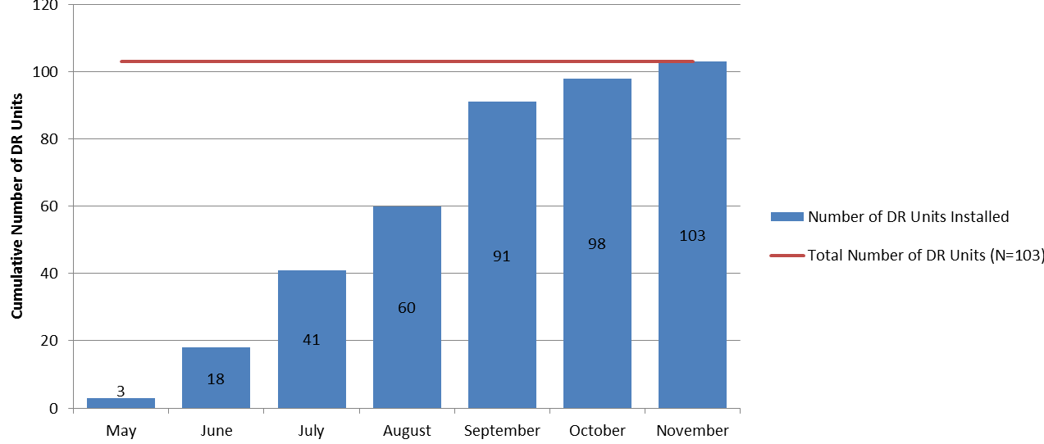
Cumulative Number of DR units Installed
Total DRs installed as of Sept 18th = 79
(based on sites estimated installation dates)

Slide 17
Appendix
Examples of products that are part of the OBSP Quality Assurance Program

Slide 18
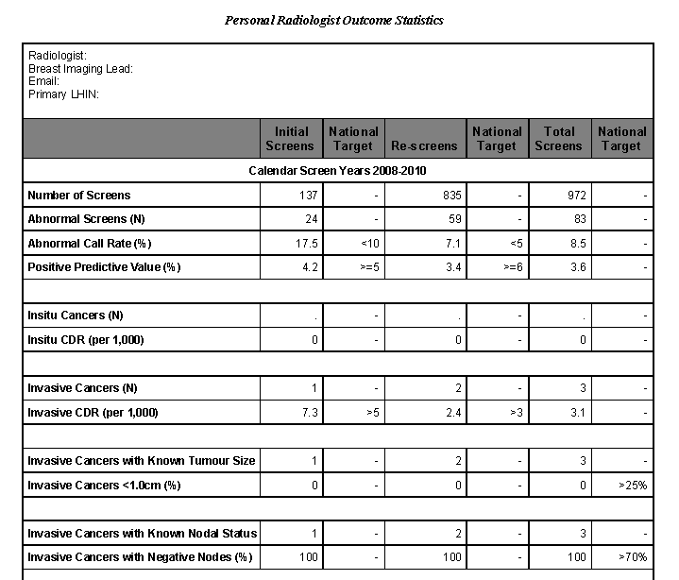
Radiologist Program Outcomes Report
EXAMPLE
(Individual Outcomes)

Slide 19
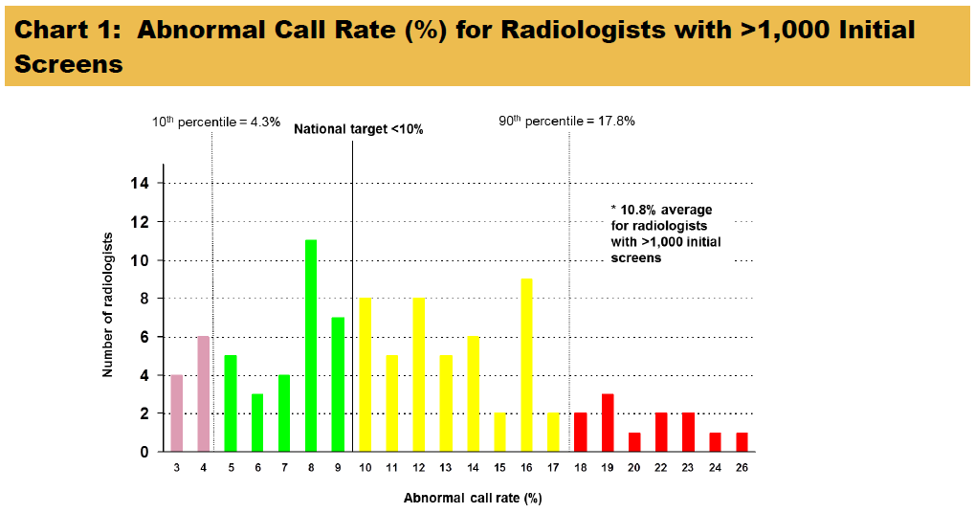
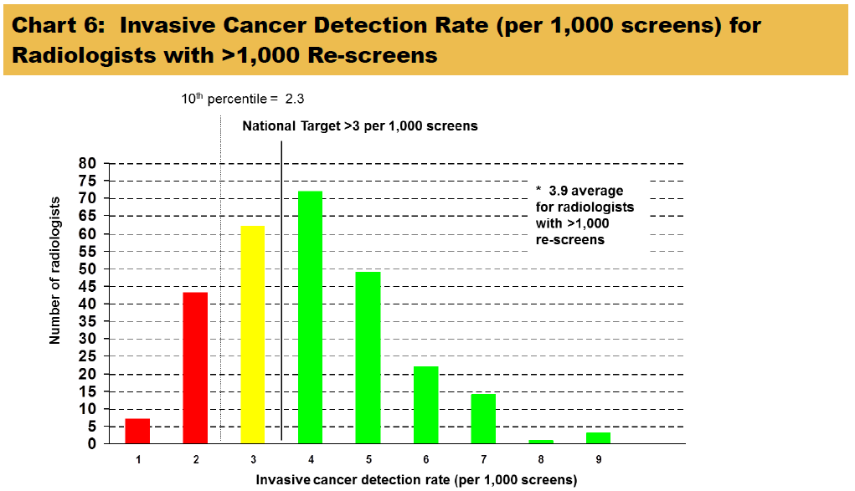
Radiologist Program Outcomes Report
Where available, national standards are provided
EXAMPLE
(Aggregate Outcomes)

Slide 20
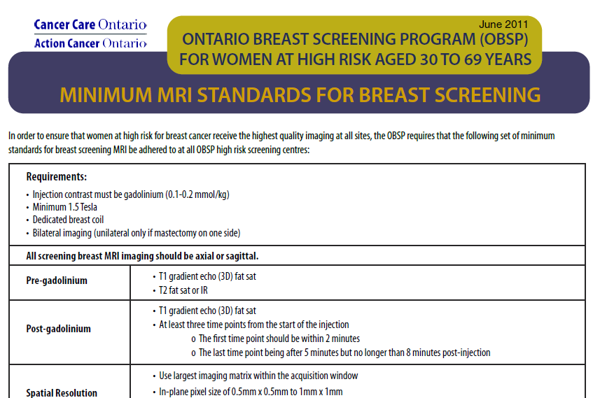
MRI Standards for the OBSP High Risk Program

Slide 21
OBSP Program Evaluation Report

