Slide 1

IDCA Conference
Optimizing Your Clinic and Practice through Process Improvement: Tools to Deliver Improved Performance for You and Your Patients
September 25, 2015

Slide 2

What We'll Cover
What is Process Improvement
1
Why Do It
2
What It Means For Your Clinic & Patients
3
How To Get Started: Some Tips & Tricks
4

Slide 3
But First – How Many of You Have Experienced…
Bottlenecks in the clinic that have impacted services?
Outdated systems that limit your staff's effectiveness?
Unclear roles/responsibilities leading to duplications?
Upset/stressed patients due to delays in results?
Inaccurate reporting on how your clinic is doing?

Slide 4
The Reality
Ineffective processes can negatively affect your clinic, without being overly apparent
Band-Aid solutions may work for a little while, but can cost you in time, staff activity and revenues
Keeping processes current allows you, your staff and the clinic to focus on the core practice: helping your patients
In the current environment, funding has decreased but expectations of quality and patient experience have increased

Slide 5
WHAT IS PROCESS IMPROVEMENT?

Slide 6
Process Improvement Is…
a systematic approach to help an organization optimize its underlying processes to achieve more efficient results
Input
ACTIVITY
Output
Built upon an organizational mindset that understands:
The organization‘s strategic goals and purposes:
Who are we, what do we do, and why do we do it?
The organization’s clients/patients and stakeholders:
Who do we serve?
The alignment needed between processes and organizational goals:
How can we do things better?

Slide 7
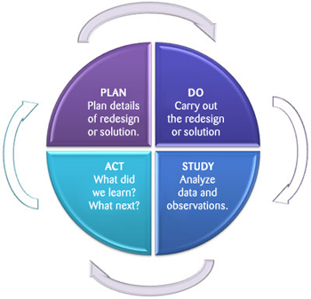
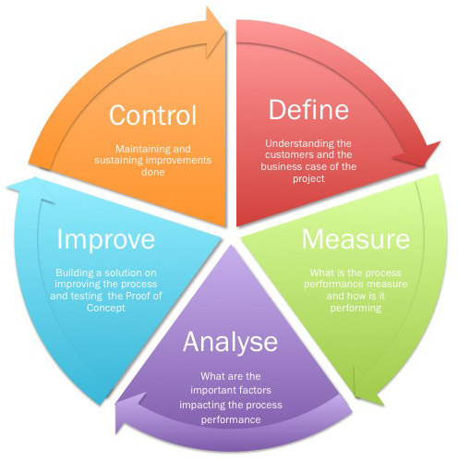
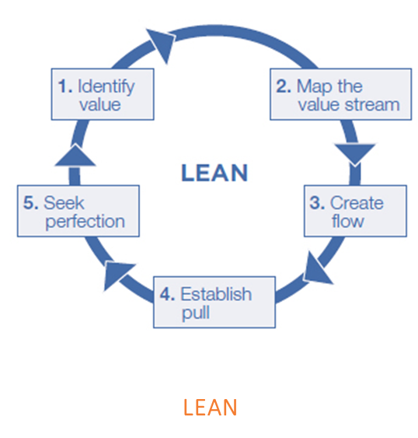
Process Improvement Methodologies Include…
PDSA (Plan Do Study Act)
SIX SIGMA
Regardless of methodology, the steps and tools used focus on creating value in the work you do
Notes:
PDSA
Identify challenges and opportunities for business improvement through self-assessment
Make improvement decisions based on identified challenges and opportunities
Develop and communicate a best-practice route to achieving continuous improvement

Slide 8
WHY DO PROCESS IMPROVEMENT?

Slide 9



Process Improvement Delivers Positive Impacts
For Your Operations
* Increase capacity
* Increase efficiency
* Reduce operating costs
* Improve safety
For Staff
* Improve workflows
* Increase turn around
* Enhance satisfaction
For Patients
* Reduce wait times
* Improve access
* Improve experience
* Impact outcomes
Good processes: efficient, profitable operation delivering quality care

Slide 10
WHAT IT CAN MEAN FOR YOU, YOUR CLINIC AND PATIENTS

Slide 11



Example 1: Workflow In Your Clinics
Problem: Inefficient workflow in a small footprint
Goal: Achieve continuous flow of people and improve productivity with logical progression of process steps
How to Solve the Problem:
Map out the physical workspace
Observe how staff and/or patients move in a physical space
Draw a diagram based on the observed movements
Draw a new diagram based on an ideal process
Compare the two diagrams to identify workflow changes
Pilot the changes and evaluate
Change
Room
Change
Room
Change
Room
Exam
Room
Prep
Room
Waiting Area
Reception
Notes:
Problem – smaller footprint, patient experience (referral) (top)
Goal (2nd row)
Why does optimizing do it? What do you need to do
Outcome – What’s the bottom line for staff, patients and operations (bottom)
e.g., Patient movement around IHF – e.g., registration, waiting room, change room, waiting room, exam, change room
e.g., Scenarios when a patient requires multiple tests – coordination between modality (e.g., ultrasound and x-ray – are they scheduled on the same day back to back?)

Slide 12
Example 1: Workflow In Your Clinics
Expected Outcome:
For Your Operations
* Effective resource allocation
* Better throughput
* Maximize use of space
For Staff
* Improve workflow
* Increase productivity
* Enhance time with patients
For Patients
* Reduce wait times
* Improve access
* Elevate experience

Slide 13
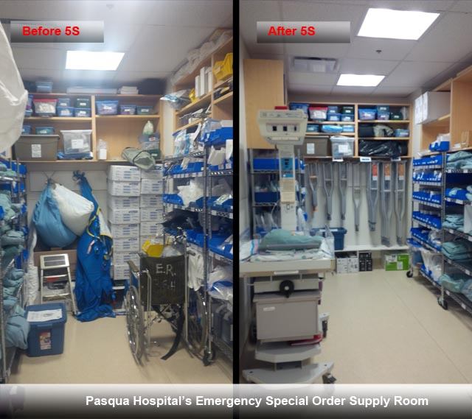
Example 2: Supplies Management
Problem: Difficult to manage and find supplies and equipment in a cluttered work area
Goal: Achieve better storage and access to supplies impacting safety, inventory management, staff satisfaction
How to Solve the Problem:
Sort – Sort through all supplies and tools and keep only the essential items
Set in Order – Systematically arrange supplies and equipment in the workplace
Shine – Keep the workplace clean and neat at the end of each shift
Standardize – Set basic housekeeping standards for everyone at the clinic
Systematize / Sustain – Maintain and review standards on an ongoing basis
Notes:
Sort – keep only necessary items in workplace
Arrange items to promote efficient workflow
Clean the work area so its neat and tidy
Set standards for a consistently organized workplace
Maintain and review standards

Slide 14
Example 2: Supplies Management
Expected Outcome:
For Your Operations
* Cleaner workspace
* Better inventory management
* Cost savings
For Staff
* Improve safety
* Better accountability
* Enhance workplace
For Patients
* Improve safety
* Better treatment
* Improve satisfaction

Slide 15
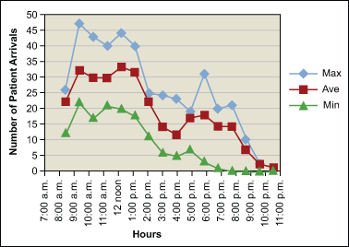
Example 3: Patient Wait Times and Satisfaction
Problem: Long wait times negatively impact patient satisfaction and referral to the practice
Goal: Achieve positive patient experience through improved patient turnaround times
How to Solve the Problem:
Listen to the Voice of the Customer and gather feedback on key pain points
Select a metric and measure the problem (e.g., # of patients waiting)
Analyze the data to explore characteristics of the problem
Brainstorm ideas to address the sub-problems
Implement the ideas and evaluate
Notes:
Based on “Creating Customer Delight”
OR, another example using Six Sigma:
http://www.isixsigma.com/new-to-six-sigma/dmaic/applying-six-sigma-improve-diagnostic-imaging/
Example No. 2: Baptist Citizens Medical Center in Alabama applied Six Sigma methods to reduce the cycle time from patient-out to next-patient-in to less than 15 minutes.
Example No 3. (e.g., peak wait times, areas with highest traffic) and divide the problem into sub-areas/sub-problems (e.g., morning, reception area, etc.) for further assessment
Solutions:
Optimize capacity and labor utilization
Improve service levels
Develop marketing plan to improve market share
Use radiology technician in CT to help transport
Rotate CT technicians in X-ray
Revisit protocols
Extend US technicians hours twice/week

Slide 16
Example 3: Patient Wait Times and Satisfaction
Expected Outcome:
For Your Operations
* Maximize throughput
* Increase referral rate
* Increase profitability
For Staff
* Improve efficiency
* Enhance engagement
* Enable ‘customer experience’
For Patients
* Decrease wait times
* Improve satisfaction
* Enhance loyalty

Slide 17
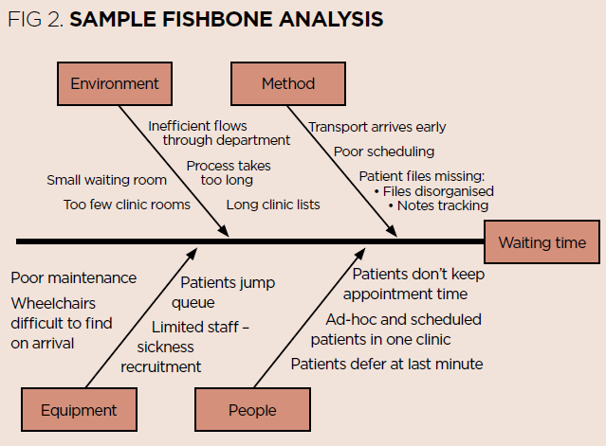
Example 4: Patient No Shows
Problem: Patients fail to show up at scheduled appointments, resulting in inefficient use of equipment, paid staff idle time, supplies wastage and non-billable time for radiologists
Goal: Achieve efficient utilization of resources and optimal revenue generation by reducing the impact of patient no-shows
How to Solve the Problem:
Facilitate a ‘5 Whys’ iterative discussion with stakeholders involved with the process
Explore the causes (issues) that are related or affect the problem (effect)
Keep asking ‘why’ to dive deeper to identify the root cause(s)
Brainstorm ideas to address the causes
Develop action plan(s) to deliver improvements
Image: https://www.infoway-inforoute.ca/en/component/edocman/1672-using-fishbone-analysis-to-investigate-problems/view-document
Notes:
Notes:
See recommendation #4 from Auditor General’s 2006 report (Source: http://www.auditor.on.ca/en/reports_en/en06/306en06.pdf)
For the three months ending December 31, 2005, two of this hospital’s sites had exceeded the patient no-show target and had an average no-show rate of almost 12%.
In order to ensure that diagnostic equipment is used efficiently and that waiting lists are minimized, it is important that CTs and MRIs are used to their full potential during operating hours.
Recommendation #4: In order to ensure that hospitals are utilizing their MRI and CT equipment efficiently, hospitals should monitor the reasons for cancellations and take proactive action where possible to minimize the impact of last-minute cancellations and no-shows.
5 Whys: Keep asking “why” until you drill into the root of the problem
http://www.diagnosticimaging.com/practice-management/what-do-about-patient-no-shows-your-radiology-practice
In the US, the national ‘no show’ average for all specialties at 5.5% (estimated by the Medical Group Management Association)
According to a 2009 Physicians Practice article, a practice with a daily (and common) average of four no-shows stands to lose $150k annually.
Unused radiopharmaceuticals (e.g., nuclear medicine) cannot be used for studies at a later date – sunk cost
Impact on patient care due to missed appointments
Possible Strategies to address ‘no shows’ – dependent on the results of the ‘5 Whys’ exercise:
Have patients sign a statement when scheduling appointments to agree to pay for supplies (e.g. ,NM) if they do not show up and do not give adequate cancellation notice (financial impetus)
Enforce a charge policy for all missed appointments
Decline to schedule patients who miss 2+ visits (or serve chronic no-show patients on a walk-in-only basis)
Improve communication with patients and their referring physicians (e.g., publish policies, send letters to patients, discussions with patients during scheduling, etc.)
Give patients a reminder call or email 1-2 days before appointment
Create a “last minute priority list” with the names of patients who can take a spot of a no-show patient last minute
Strategically overbook your slowest hours of the day
The 2009 American College of Physicians study indicates you can also give more responsibility to the patient by allowing him or her to suggest their own appointment times. Researchers found that out of 11,000 patients, those who were asked for their preferred visit time were far more likely to appear for the appointment.

Slide 18
Example 4: Patient No Shows
Expected Outcome:
For Your Operations
* Higher % booked vs. billed
* Reduce wastage of supplies
* Better staff utilization
For Staff
* Less idle time
* Reduce frustration
* Enhance time with patient
For Patients
* Less waiting time
* Easier access
* Better overall experience

Slide 19
HOW TO GET STARTED

Slide 20
Six Guiding Principles To Start
1
Processes need to align to clinic goals: An organization’s strategic goals should provide the key direction for any Process Improvement exercise.
Patient/Client focus is at the core: Patient needs underscore the importance of aligning business processes to achieve higher patient satisfaction – “Voice of Customer” needs to be factored in when reviewing or redesigning any process.
Benchmarks are important to monitor success: Process tools place a lot of emphasis on “measurable results”. Benchmarks may be internal, external or directed by the senior management as an aspirational target.
Clear Process Owners drive awareness, engagement and alignment: For any process to be controllable, it is essential to have clear owners and definitions of success/failure of the process.
Focus on what you can control: Look at the processes, behaviours where you have decision making authority to ensure impact of actions.
All processes count: Size and type don't matter – mix it up!
2
3
4
5
6

Slide 21
Four Steps To Remember
Identify The Process To Be Improved
Analyze Current Process
Analyze the current procedure to fully understand the process and set realistic improvement objectives.
Recommend Changes
Categorize and prioritize the main problems and possibilities, evaluate alternative solutions.
Document the current process by creating a flowchart or "organization map.”
Identify "disconnects" in the process that inhibit the efficiency and effectiveness of the process.
Implement Improvements
Create an improvement strategy that includes what steps in the process are broken, why and how they should be improved.
The identification of key processes can be a formal or informal exercise.
Can be derived from strategic and tactical priorities, or based on obvious performance gaps.
Obtain commitment and support of management.
1
2
3
4
20

Slide 22
Your Checklist for Implementation Success
Executive/Leadership buy-in to proceed
A clear statement of why the process is changing
A solid vision of how it will be different post change
Clear, concise and easily understood recommendations
Sound implementation plan
Adequate resources and time
Communication plans, roles and responsibilities, benefits, metrics
Buy-in of those affected by the changes
Notes:
Note:
- Change management strategies to ensure sustainable change especially with clinicians

Slide 23
“If you always do what you’ve always done, you’ll always get what you’ve always got.”
- Henry Ford

Slide 24
Questions

Slide 25



Contact Us
How can we help you?
Terri Lohnes, VP Healthcare and Not-for-Profit Group
416.649.6017
terri.lohnes@OptimusSbr.com
CHOICE TOOLS. PRECISION AIM. BOLD ATTITUDE.
Merger Support

